Slide 1

Alumni Management System
Date: 20th April 2021
M.V.N.S Kavya: 17WH1A05A2
Suhana : 17WH1A0589
G. Tejashwini : 18WH5A0519
Internal Guide: Mr. K. Bhargav Ram
Designation: Assistant Professor
Department of Computer Science & Engineering
BVRIT HYDERABAD College of Engineering for Women

Slide 2

ABSTRACT
Why Should I Study this course?
Alumni Management System is a web application that allows alumni to
upload their details, upload materials, post job opportunities, view statistics of college placement achievements. It also allows students to view job opportunities, view alumni details, view materials uploaded by alumni, it also allows students to participate in group chats with alumni members.
The administrator for this application can verify and authenticate alumni, search for alumni details, generate reports, create events, send messages and emails to alumni members and students to notify them of any events. The admin creates the group chats.
Examples
BVRIT HYDERABAD College of Engineering for Women

Slide 3

What is an Alumni Management System?
Alumni Management System is a user interactive web application that maintains records of alumni along with student and staff details.
Why build an Alumni Management System?
Alumni of a college generally stay in touch with their close friends but do not stay in touch with other college mates.
Contact between alumni, faculty and students can be used to gain references, insight into the industry and forge business connections.

Slide 4
System Requirements
Why Should I Study this course?
Environment | Specifications
Hardware | 2GB Storage space
 | 4GB RAM
 | Intel I5 Core Processor
Software | PHP, MySQL, HTML, CSS
 | OS: Microsoft Windows 10
Examples
BVRIT HYDERABAD College of Engineering for Women

Slide 5
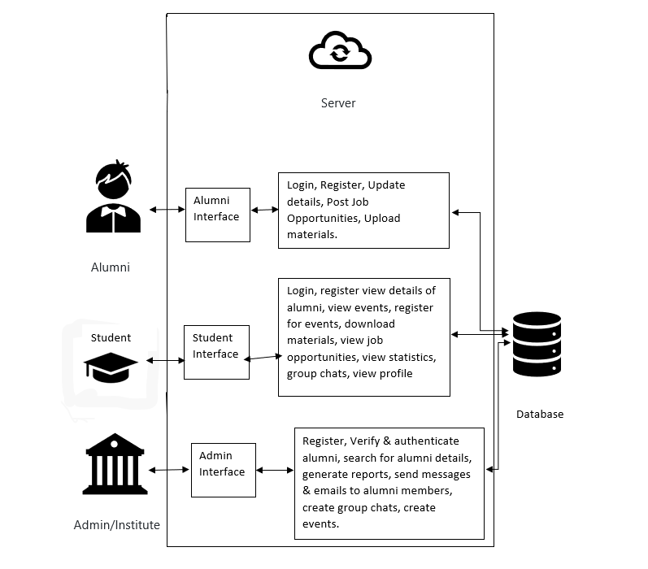
ARCHITECTURE

Slide 6
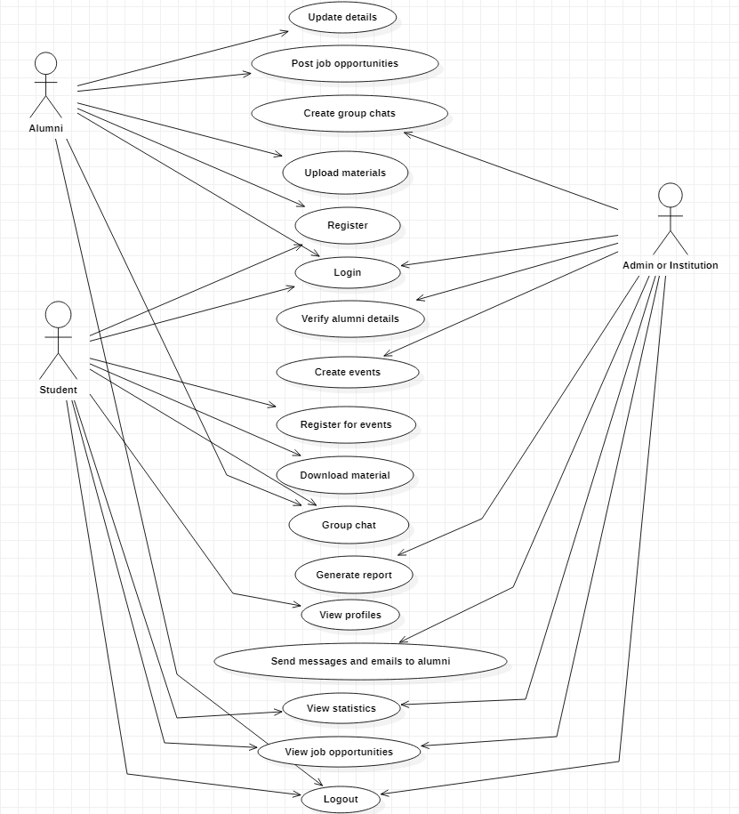
USECASE DIAGRAM
BVRIT HYDERABAD College of Engineering for Women

Slide 7
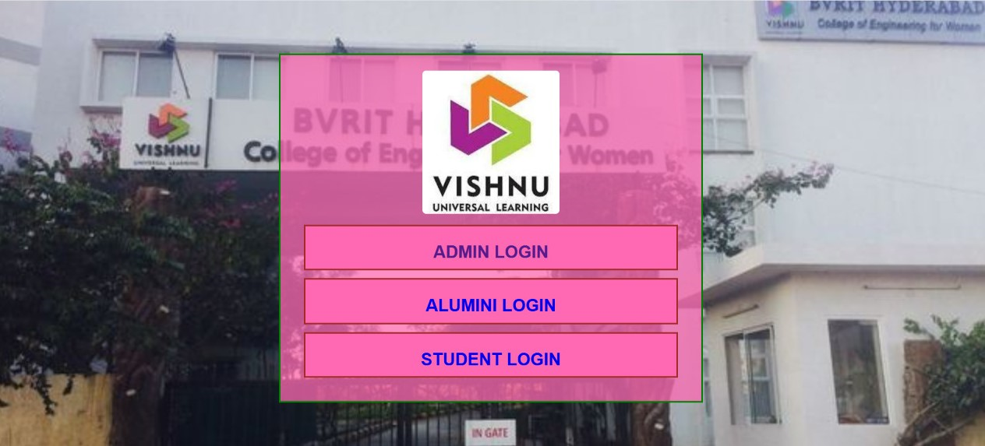
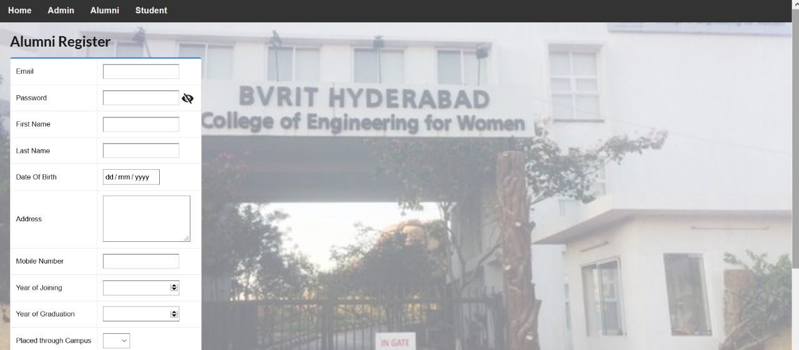

Slide 8
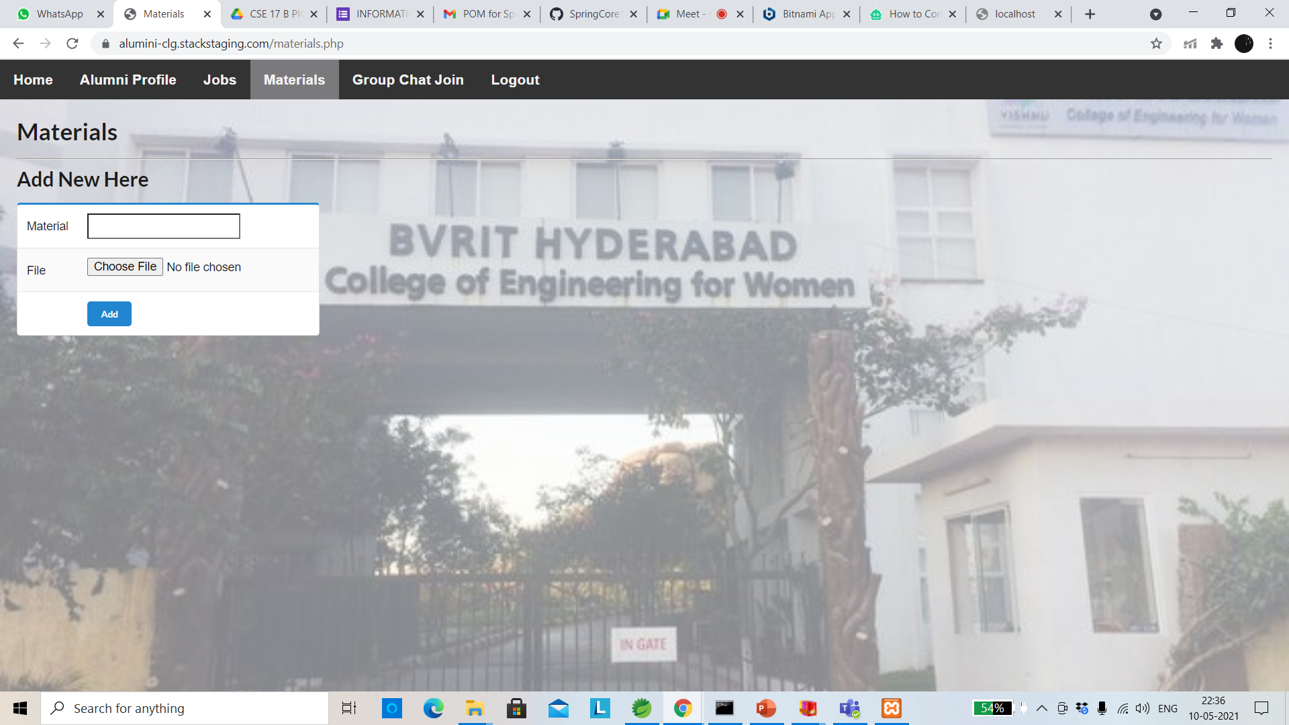
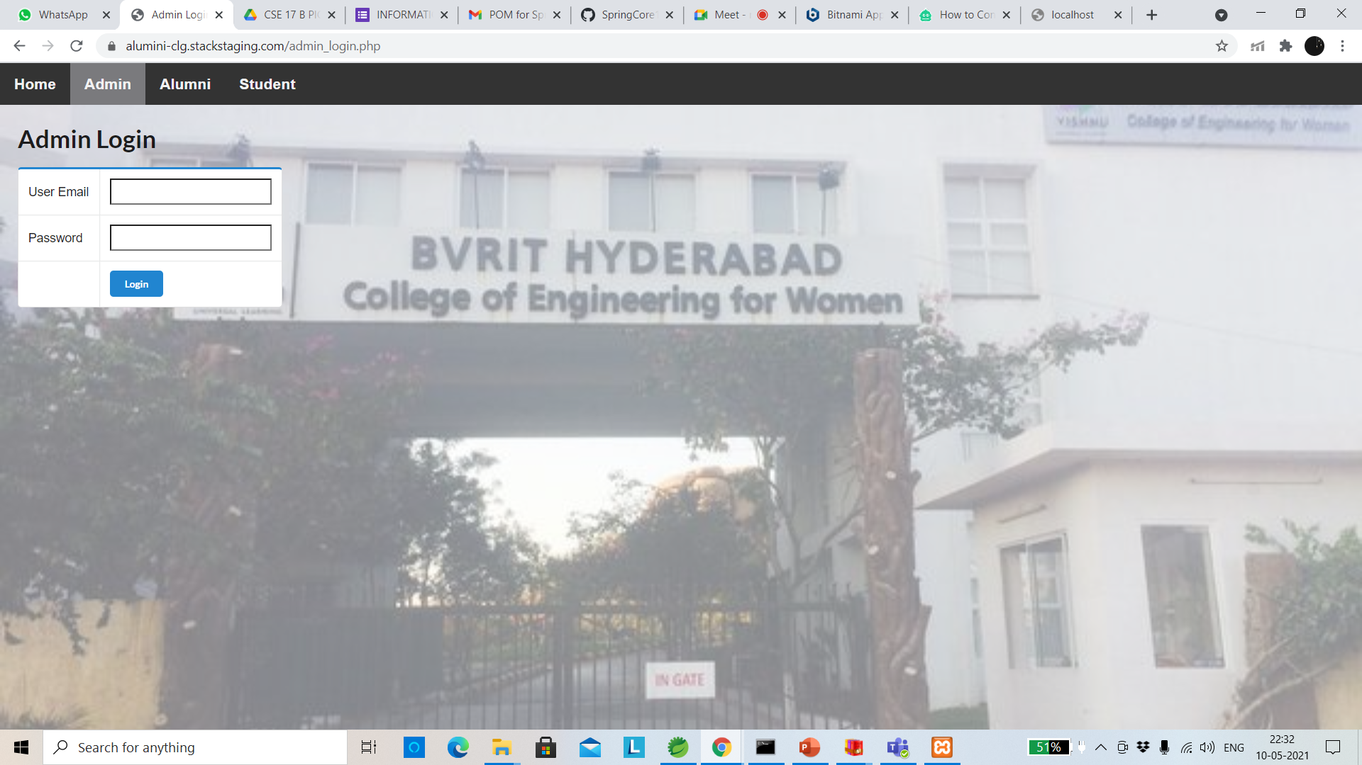
Implementation and output

Slide 9
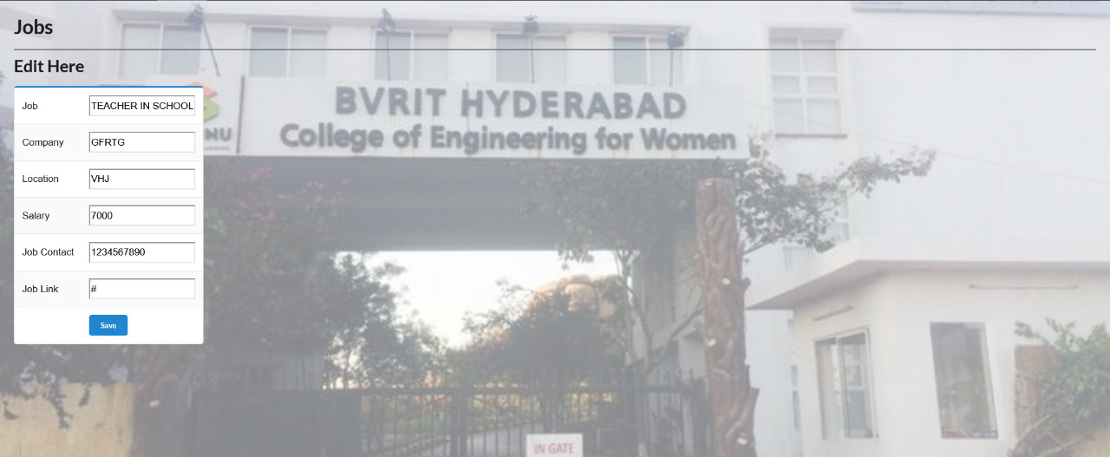
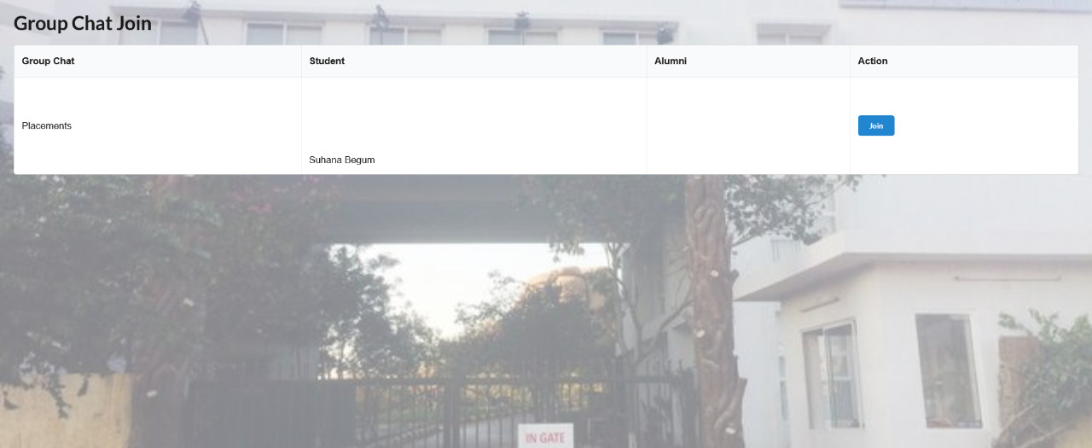

Slide 10
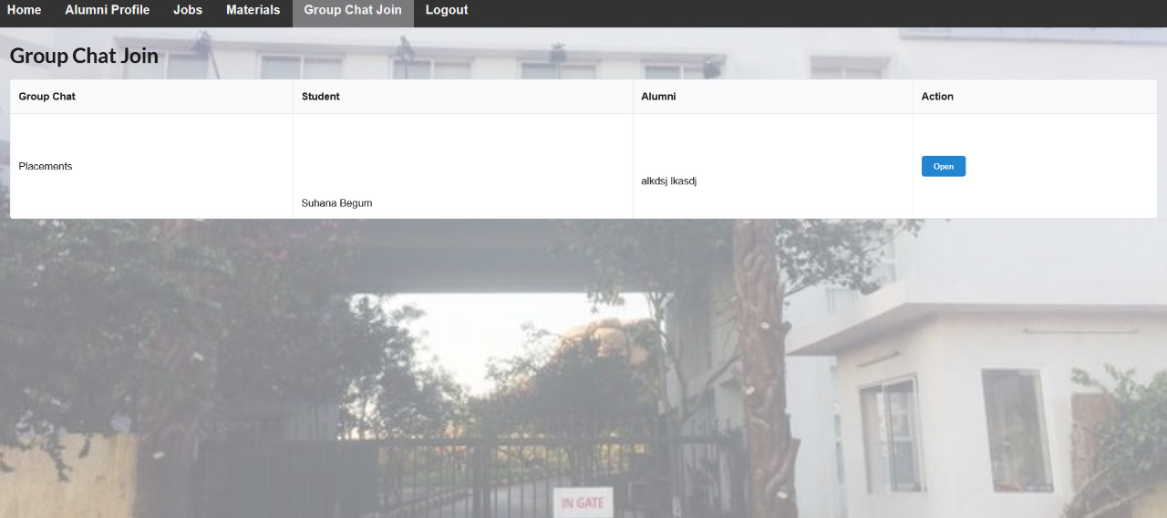
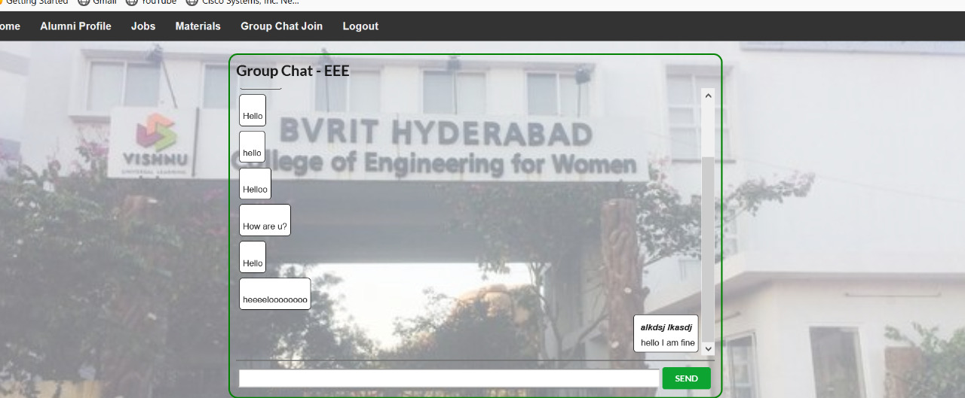

Slide 11
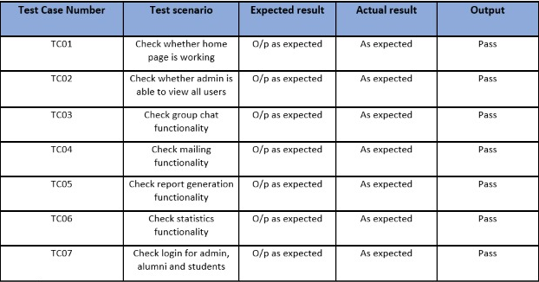
Test cases
BVRIT HYDERABAD College of Engineering for Women

Slide 12
References
Why Should I Study this course?
Design and Development of Alumni Tracking System for Public and Private HEIs, Ruth G. Luciano, Gloria M. Alcantara, Renato Bauat, Jr. INTERNATIONAL JOURNAL OF SCIENTIFIC & TECHNOLOGY RESEARCH VOLUME 9, ISSUE 06, JUNE 2020 (Base paper)
University Based Job Recommender & Alumni System Akeem Olowolayemo, Kamaleiah Harun, Teddy Mantoro 2018 4th International Conference on Computing, Engineering, and Design (ICCED) (IEEE Paper)
Alumni System KINGDOM OF SAUDI ARABIA Ministry of Education Majmaah University College of science Department of Computer Science & Info
Alumni Tracking System Mihir Jayavant, Shashank Kawle, Priti Khergamkar, Shital Gurale, Prof. Reena Somani (IOSRJEN)
Examples
BVRIT HYDERABAD College of Engineering for Women

Slide 13
Thankyou
BVRIT HYDERABAD College of Engineering for Women

